Slide 1

Data Processing Financial Data Science
Team 4 Week 2 Assignment: Comprehensive analysis of data preprocessing for cryptocurrency datasets, missing data handling strategies, and foundational financial analysis techniques.

Slide 2

Problem 1: Calendar Alignment Strategy
01
02
Challenge Identification
Synthetic Value Strategy
Cryptocurrencies trade 24/7 while stocks only trade on weekdays, creating alignment issues for unified analysis.
Added synthetic weekend values to stock data using median of weekday closing prices, preserving crypto data integrity.
03
Median Selection Rationale
Median chosen for robustness against extreme values and to avoid artificial trend creation through interpolation.
Results showed mean convergence toward median values, with systematic variance reduction due to weekend price stabilization effects.

Slide 3
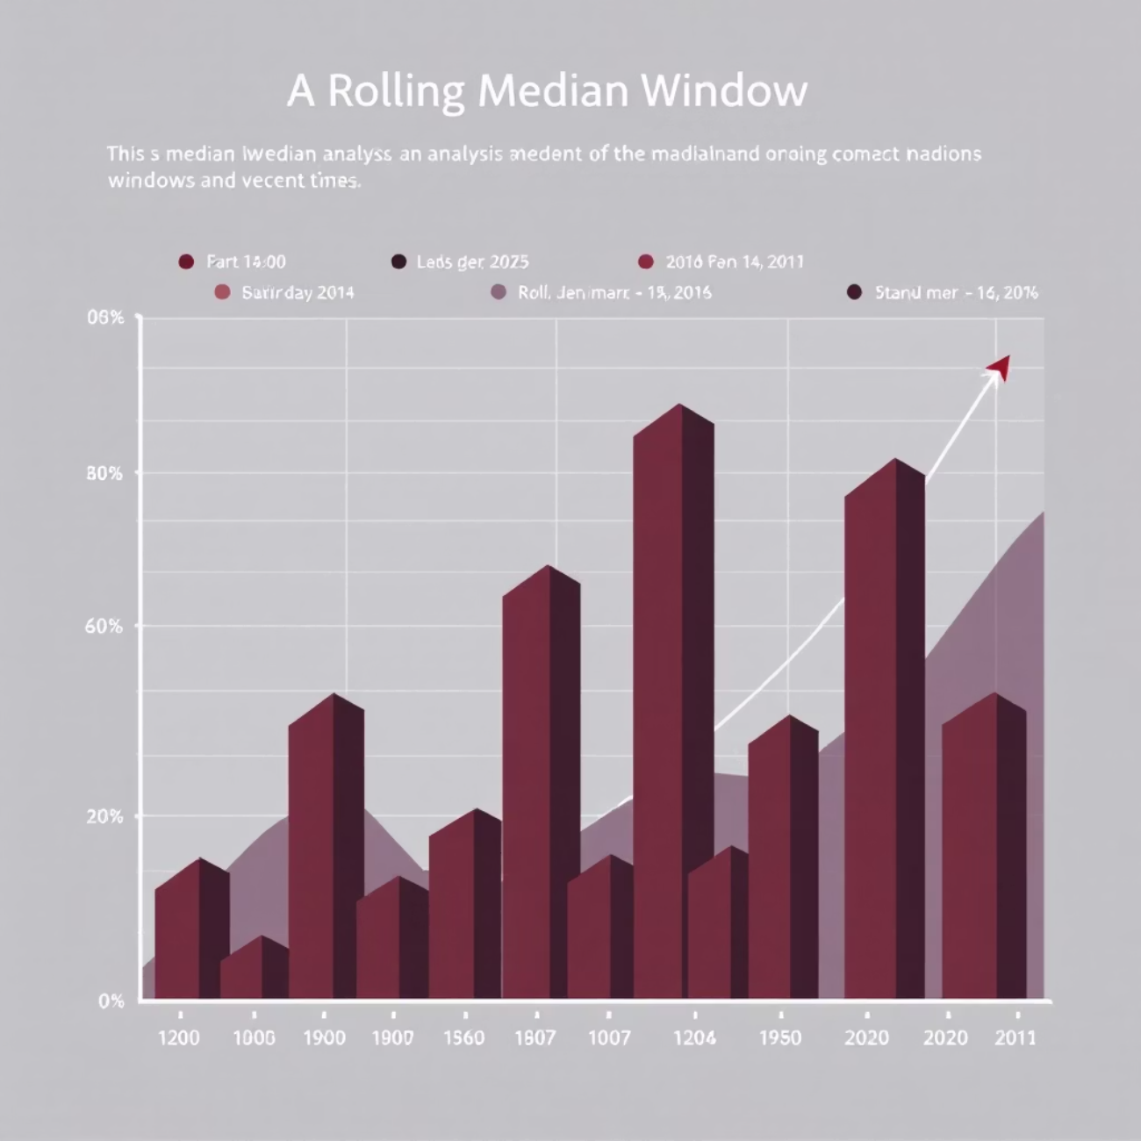
Problem 2: Rolling Median Window Optimization
Evaluated multiple window sizes (3, 7, 14, 20, 30, and 60 days) for missing value imputation using rolling median approach.
Key Findings
30-day window achieved lowest MAE
60-day window showed lowest RMSE
MAE provides more interpretable results
RMSE penalizes large errors more severely
Selected Solution: 30-day window based on MAE stability and interpretability for this financial dataset.

Slide 4


Problem 3: Simple Imputation Methods Comparison
Forward Fill
Backward Fill
Uses previous available value to fill gaps. MAE: 323.76, RMSE: 362.69
Uses next available value for imputation. MAE: 323.74, RMSE: 362.62
Combined Method
Sequential forward-backward approach for remaining gaps. Similar performance metrics.
MAPE Issue: MAPE returned infinite values due to zero denominators in the dataset, making it unsuitable for evaluation.
Winner: Backward fill method showed marginal superiority in both MAE and RMSE metrics, utilizing more recent information for better accuracy.

Slide 5




Problem 4: Advanced Interpolation Techniques
Linear Interpolation
Polynomial Interpolation
Exponential Smoothing
Straight-line connection between gap endpoints. Provides stable baseline performance with minimal assumptions.
Low-degree (2nd order) polynomial introducing controlled curvature. Achieved lowest MAE for best average accuracy.
Recursive estimation with greater weight on recent observations. Achieved lowest RMSE, minimizing large errors.
Recommendation: Exponential smoothing for financial applications due to superior RMSE performance, crucial for limiting large prediction errors.

Slide 6

Problem 5: Evaluation Metrics Troubleshooting
Issues Encountered
Solutions Implemented
MAPE Problem: Division by zero when actual values are zero, resulting in infinite values
sMAPE Replacement: Symmetric MAPE using sum of absolute values in denominator
Correlation NaN: Zero variance in flat trend series prevents correlation calculation
Variance Checks: Pre-calculation validation to handle zero variance cases
Misleading Metrics: Some indicators unreliable with poor data variance
Robust Focus: Emphasis on MAE and sMAPE for reliable evaluation
These corrections stabilized evaluation indices, making results more reliable and interpretable for production use.

Slide 7

Problem 6: K-Nearest Neighbors Imputation
4
92.5
77.4
K Values Tested
KNN MAE Result
Median MAE
K = 5, 10, 15, 20
Both basic and scaled versions
Superior performance
Method Variations
Key Findings
Basic KNN: Direct application without normalization
Scaling showed no improvement over basic KNN. Median imputation outperformed both KNN variants with lower MAE (77.4 vs 92.5) and RMSE (169.7 vs 185.1).
Scaled KNN: StandardScaler preprocessing for distance smoothing
Median Baseline: Simple median substitution comparison
Conclusion: Simple median imputation proved more effective than sophisticated KNN approaches for this dataset.

Slide 8




Problem 7
Utility Functions in Cryptocurrency Investing
Utility functions model investor attitudes toward risk and wealth in economic theory. In crypto markets with extreme volatility, these functions help understand different investor behaviors.
Risk Seeker
Risk Averse
Risk Neutral
Chases high returns despite significant risk
Prefers stability and avoiding losses
Focuses only on expected value, ignoring variance
Investor Characteristics Shape Risk Tolerance
Younger Investors
Older Investors
Have time to recover from losses, tend toward risk-seeking behavior
Focus on capital preservation, utility resembles \sqrt{W}
Wealthy Investors
Lower-Income Investors
Can assume greater risk as losses don't threaten security
More conservative - large losses have dramatic consequences
Handling Missing Data
Risk-Averse Approach
Risk-Seeking Approach
Fills gaps with pessimistic estimates (lower returns, higher volatility) to avoid underestimating risk
Ignores gaps or fills with optimistic assumptions, believing markets will trend upward
Example: 28-year-old with small capital invests in Bitcoin using U(W) = W^2. Missing data replaced with market averages. 65-year-old retiree uses U(W) = \sqrt{W} - missing data signals instability, leading to avoidance.
Key Insight: Utility functions capture how different investors evaluate risk and handle uncertainty in cryptocurrency markets

Slide 9




Problem 8: Dataset Integration
Crypto Dataset
Daily cryptocurrency pricing data with 24/7 trading patterns
Stock Dataset
Daily stock market data with weekday-only trading schedules
Unified Dataset
Combined dataset with common time range and median-filled missing values
Successfully merged two distinct financial datasets by establishing a common temporal framework and applying proven median imputation methodology. This created a comprehensive dataset suitable for comparative analysis across traditional and digital assets.

Slide 10
Problem 9
Return Comparison
Volatility Patterns
Distribution Shape
Simple and log returns show near-equality for small daily movements but diverge slightly during larger price jumps. Log returns consistently display lower mean values due to compound capitalization effects.
Standard deviation remains similar between simple and log returns for most assets. High-volatility securities show slightly higher std in simple returns as large movements inflate dispersion.
Simple returns exhibit strong positive skewness with heavy right tails. Log returns demonstrate better symmetry and normality, except BTC showing negative skewness with heavy downside tails.
Correlation Analysis Reveals Key Insights
Equity Correlations
Crypto vs Stocks
Crypto Relationship
Extremely high positive correlations among stocks indicate strong systematic risk factors and limited diversification benefits within the equity basket.
BTC and ETH show very low to zero correlations with equities, offering potential diversification benefits in mixed portfolios.
BTC-ETH correlation appears weakly negative in this sample—an unusual finding likely explained by sample size or specific time period characteristics.
Log returns provide superior statistical properties for modeling, offering better symmetry and normality compared to simple returns, making them the preferred choice for quantitative financial analysis.

Slide 11

Thank You
We appreciate your attention and engagement with our comprehensive data preprocessing analysis for financial time series datasets.
Key Achievements
Practical Insights
Future Directions
Successfully addressed calendar alignment, tested multiple imputation methods, and resolved evaluation metric issues
Demonstrated that simple methods often outperform complex approaches in financial data preprocessing tasks
Foundation established for advanced financial analysis and machine learning applications

